Slide 1




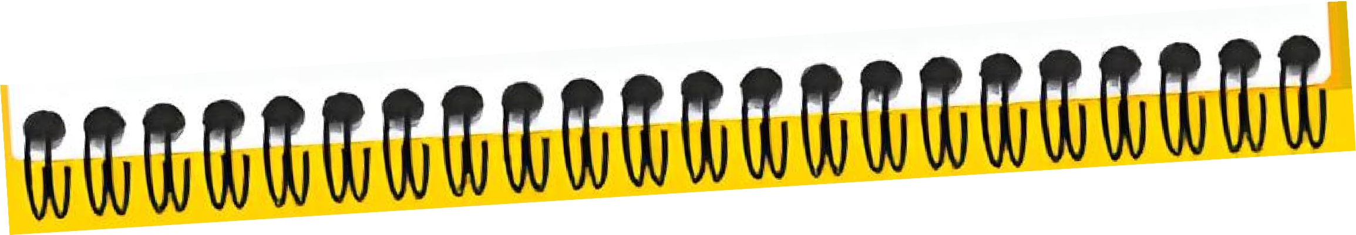



Slide 2


Slide 4


Slide 5


Nicole Stroj
Head of Innovation Management at RBI

Slide 7

Gábor Rajna
Retail Board Member at RBHU

Slide 9




Budapest
Tue | 13.10.
08:30
Wed | 14.10.
09:00
Thu | 15.10.
09:00
Fri | 16.10.
09:00
Workmode Reflection
Agenda for the Day
Opening
Innovation Theory
Design Thinking
Design Thinking
Individual
Homework
Teaming
Lunch Break
Lunch Break
Lunch Break
Lunch Break
Individual Homework
Culture
Culture
Design Thinking
Design Thinking
Facilitation
Design Thinking
Innovation SPOC Session
Reflection 16:00
Reflection RBHU CEO
Session
18:00
18:45
Boat Cruise
Reflection 18:00
19:00
Welcome Night
Reflection 18:00

Slide 11





























Faces on Stage
Orga Team
Christine
Schättin
Nadja
Jevtic
Kitti
Lucz-Szabó
Lili
Horvath
Sarah
Straub
Jannik
Böckenholt
Franziska
Hecht
Julia
Szilagyi
Christoph
Broggiato
1
2
3
4
5
6
7
8
9
Arkadii | Dejana | Melanie | Alexander | Stela | Ondrej | Aliaksandr | Andrea | Slavomir
Vyhivski | Kapetanovic | Hartl | Stanculovic | Tati | Borkovec | Marsheuski | Pesic | Nad
Coaches
10
11
12
13
14
15
16
17
18
Zerina | Pablo | Tudor | Orjeta | Elmira | Volodymyr | Michaela | Dávid | Cora
Delija | Cejas Romanelli | Juravlea | Rizvanolli | Milićević | Zubchenko | Stephen | Švaňa | Moraru

Slide 12



Special thanks to the Hungarian team
Vazul
Tóth
Szabolcs
Tóth

Slide 13


Slide 14










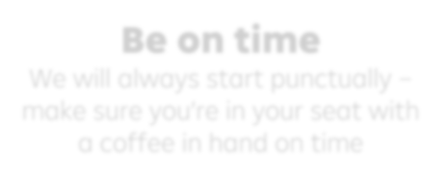




Digital detox
Don’t use your laptop or phone during sessions, unless told to as part of a session
Keep your mind open
This is a safe space for learning
and new ideas
Be on time
We will always start punctually – make sure you’re in your seat with a coffee in hand on time
No interruptions
Please make sure not to have calls during the week

Slide 15





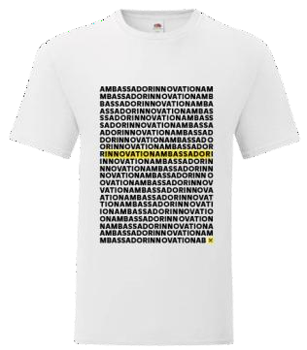
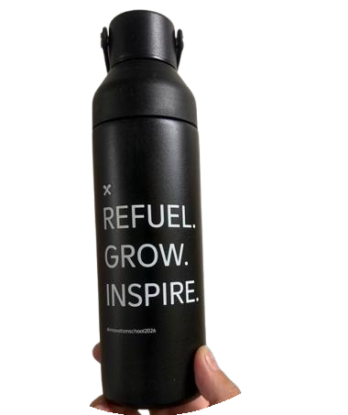





Goodies
Please wear me on Day 3!
Put your name on your belongings

Slide 16

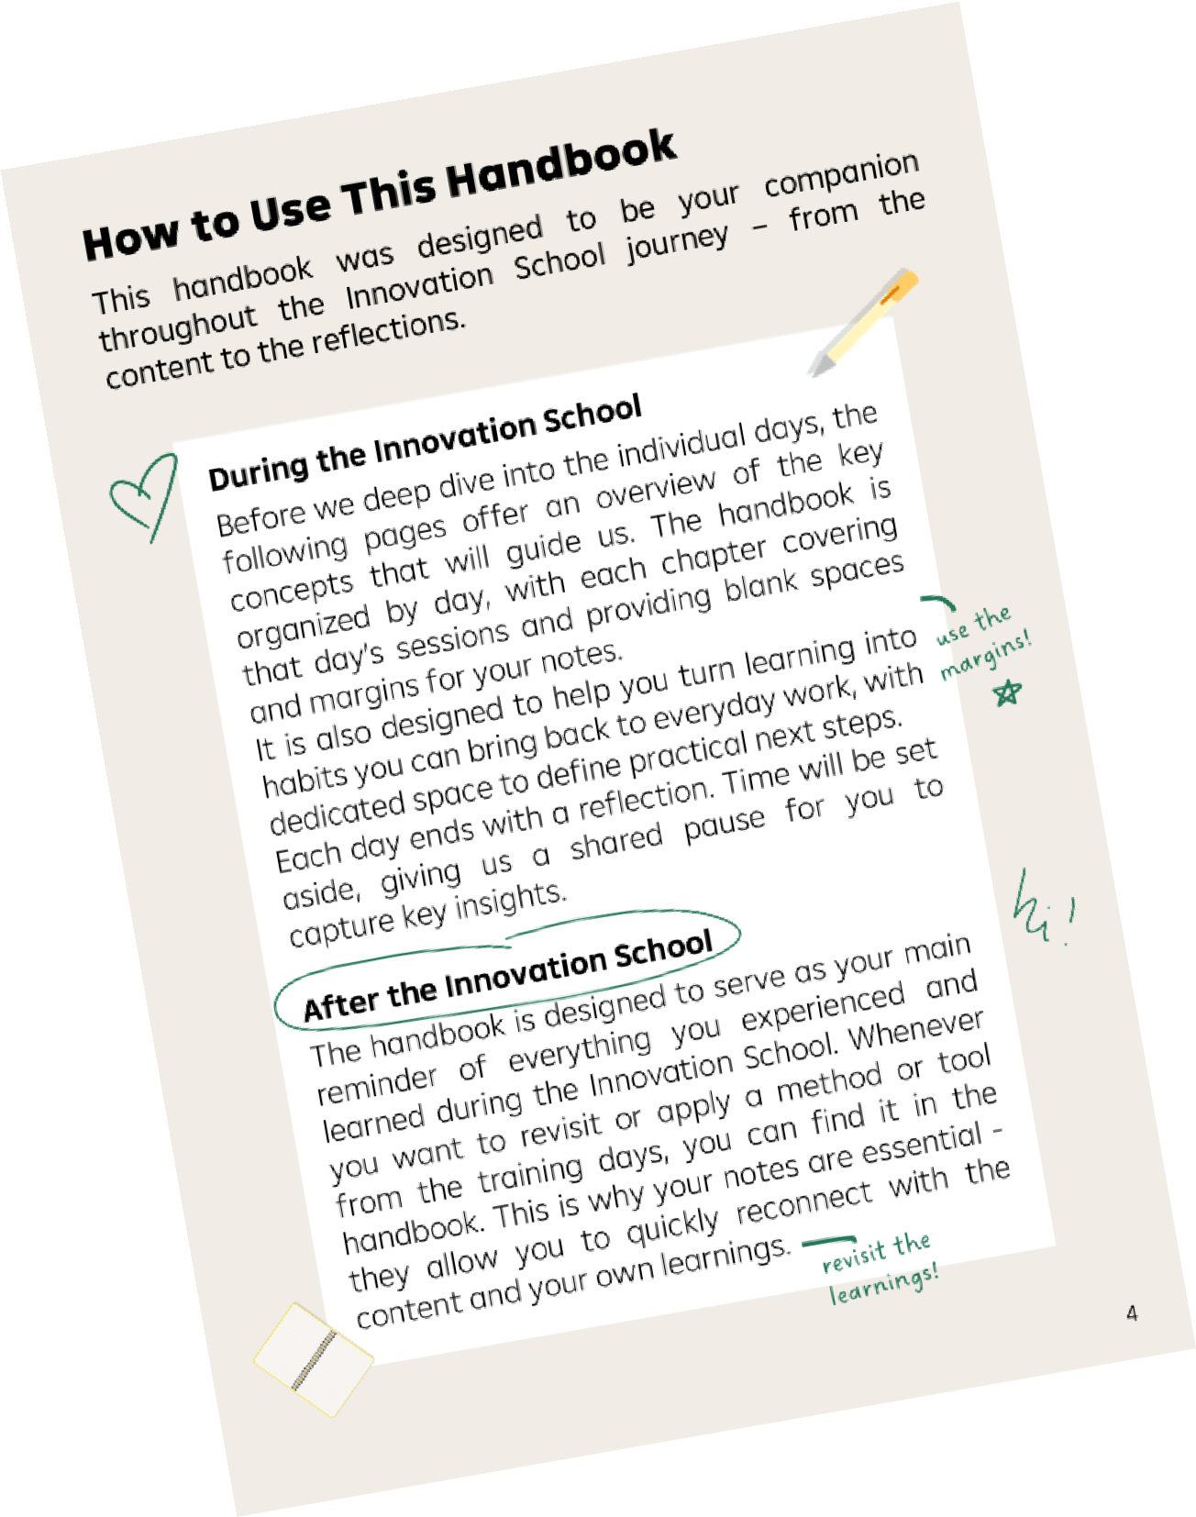
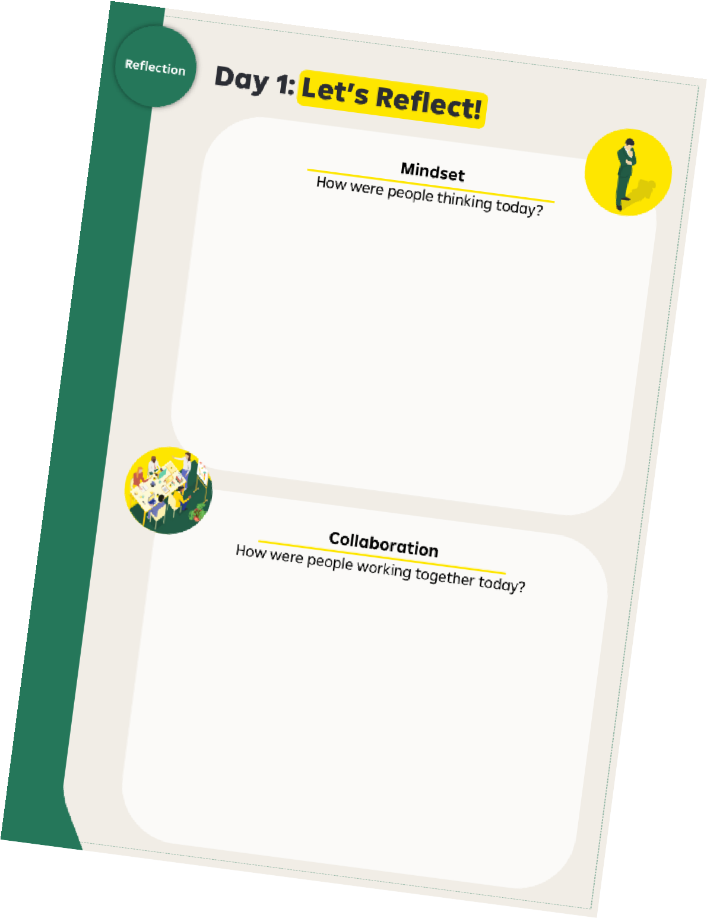

How to Use the Handbook
Innovation School 2026

Slide 17







Food & Drinks
Grab coffee, drinks & snacks
any time during the day
Lunch is always around midday in the hotel restaurant

Slide 18


Communication
#1
Your coach is your main contact person, always ask them first about any topics that may arise
Use MS Teams as the main
communication channel

Slide 19


Leave Your Mark
People make Innovation happen!
I really enjoyed…
It would have been nice to…
My favourite part was…
I wasn‘t a fan of…
Community Wall
Feedback Wall

Slide 20



Innovation School 2026
Revisiting the Foundation

Slide 21

Innovation School 2026

Slide 22




There has to be a better way!
Innovation School 2026
There has to be a better way!
Complicated
processes
Customer friction
Structure
Manual tasks
Methods
Support
Guidance

Slide 23
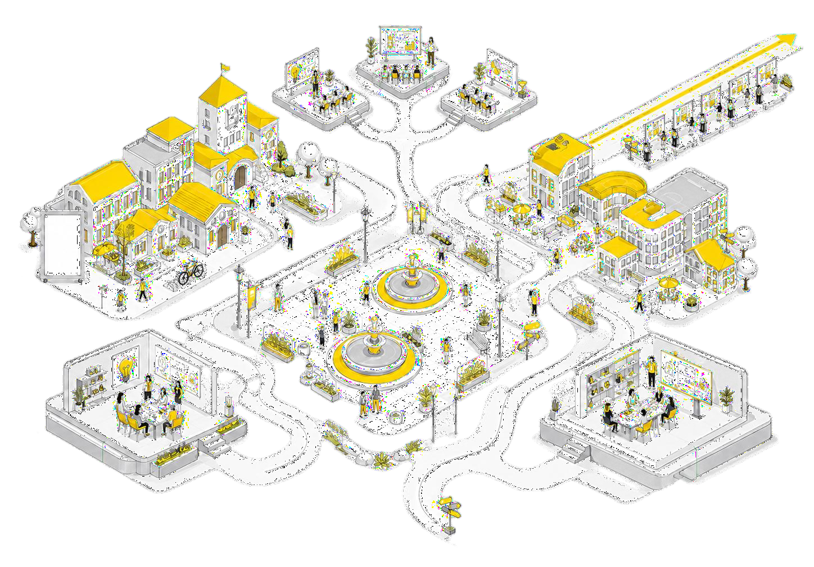


Innovation School 2026

Slide 24
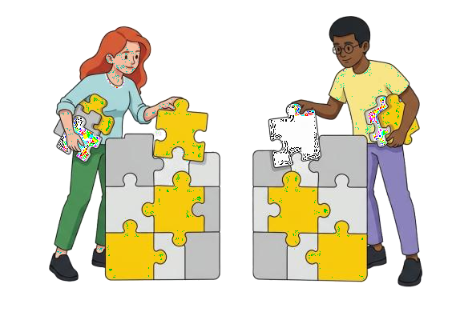


Innovation School 2026

Slide 25


Becoming an Innovation Ambassador
Innovation School 2026
Learn it.
through new methods, mindsets
and perspectives
01
02
Apply it.
by creating meaningful
improvements in your daily work.
03
Share it.
by inspiring others and helping
innovation spread across RBI.

Slide 26
Big Picture of Innovation
Exploring the Why and Harnessing Impulse Ideas

Slide 27
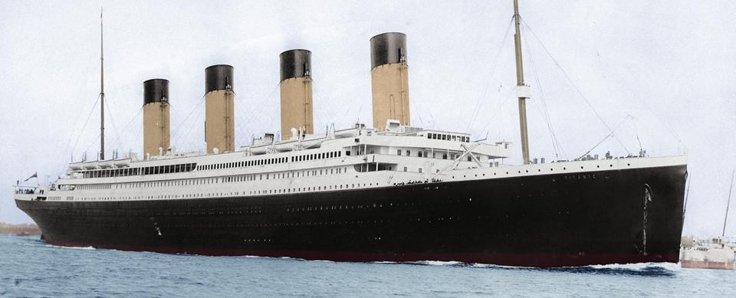
Why did the Titanic sink?
Big picture of innovation

Slide 28








„We didn‘t do anything wrong, but somehow, we lost.“
Stephen Elop - NOKIA
Big picture of innovation

Slide 29




44%
Big picture of innovation
~60%
of US public companies have failed to create value
Morgan Stanley (2023)
52%
Fortune 500 companies
gone since 2000
of today’s industry leaders held that position for at least 5 years, down from 77%
BCG (2016)
KPMG (2024)

Slide 30
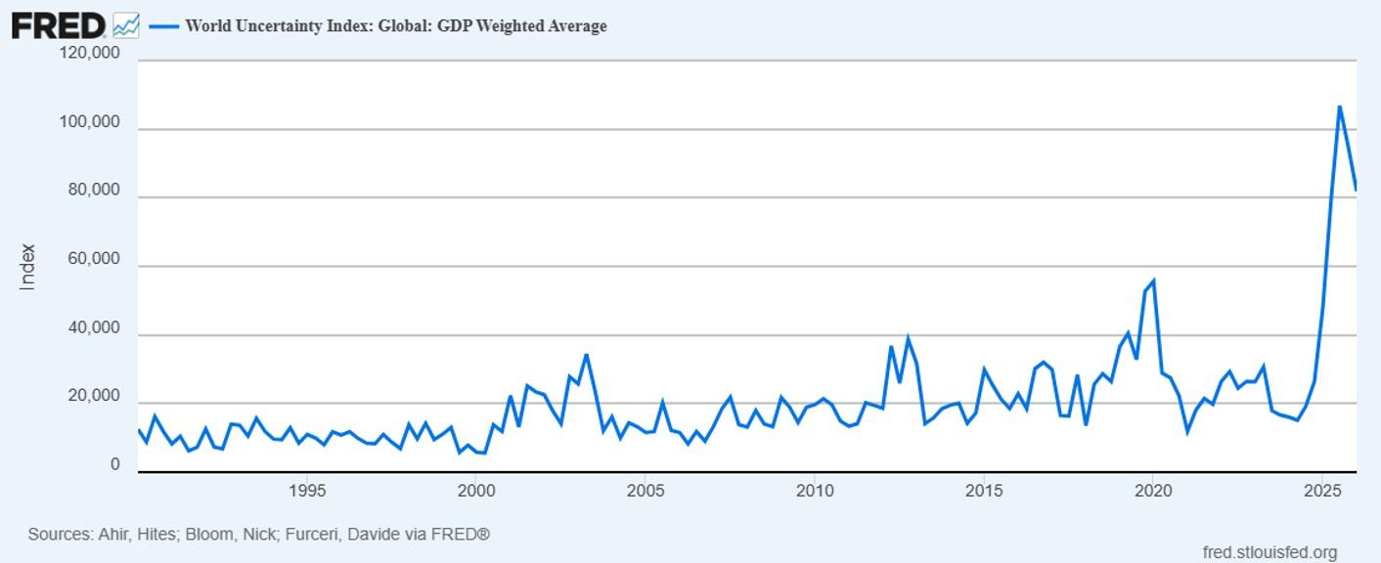


Turbulence Is Here to Stay
Big picture of innovation

Slide 31
Anyone
Big picture of innovation
A Day In The Life As An Entrepreneur
“I’m good. I don’t know why I get
so down on myself“
“Give up the good for the great!“
“IT’S WORKING”“
“Wait a second. My life is great.“
“I‘m excited“
“I was wrong. I suck!“
“I messed up“ “Ugh! This is hard“
“I think I’m going
bankrupt“

Slide 32







In the Face of…
Change
Big picture of innovation
Change

Slide 33



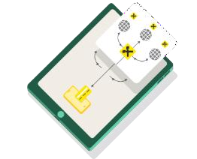







What is Innovation for RBI?
Big picture of innovation
vs.
Adding features
from scratch
Novel application of existing technology
Improving functionality
of product features
„Innovation is the practical translation of new ideas into new or improved products, services or processes that ultimately creates value“.
- RBI‘s definition of Innovation formed in 2017

Slide 34


Which myths do you hear very often about
innovation?
Big picture of innovation

Slide 35















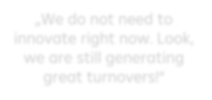
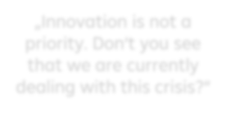
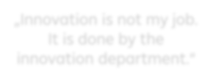











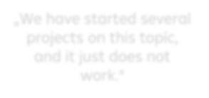


6 Innovation Myths
Big picture of innovation
1
2
3
„We do not need to innovate right now. Look, we are still generating great turnovers!“
„Innovation is not a priority. Don‘t you see that we are currently dealing with this crisis?“
„Innovation is not my job.
It is done by the innovation department.“
4
5
6
„We have started several projects on this topic, and it just does not work.“
„I have an idea, let’s implement it!“
„Innovation means creativity and post its.“

Slide 36




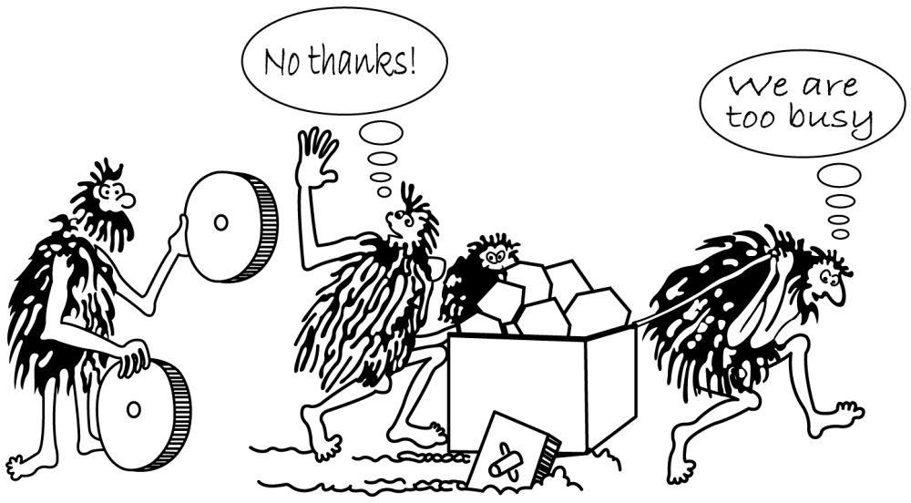
Big picture of innovation
Competitive Advantage
Growth Opportunities
Why We Always Need Innovation
Market Adaption
Resilience
Customer Satisfaction
Talent Attraction
1
Efficiency Gains
Brand Reputation
„We do not need to innovate right now. Look, we are still generating great turnovers!“

Slide 37


Big picture of innovation
Corporate Longevity
In Fact…
Companies investing in innovation during downturns outperform peers in recovery, with higher growth rate and market share
Study by McKinsey
Only 10% of those that miss this opportunity manage to catch up later
2
„Innovation is not a priority. Don‘t you see that we are currently dealing with this crisis?“
Example - Pandemic Response:
During the COVID-19 pandemic, companies like Zoom saw exponential growth by providing essential remote communication tools. Meanwhile, many businesses pivoted to online platforms to maintain operations, showcasing the critical role of digital innovation.

Slide 38
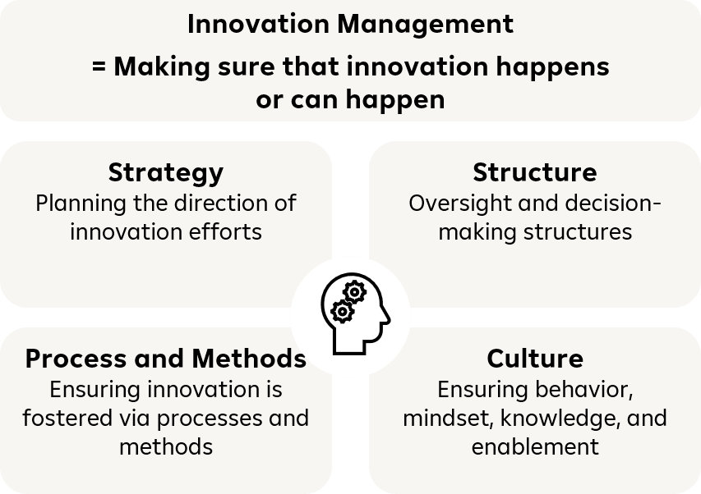


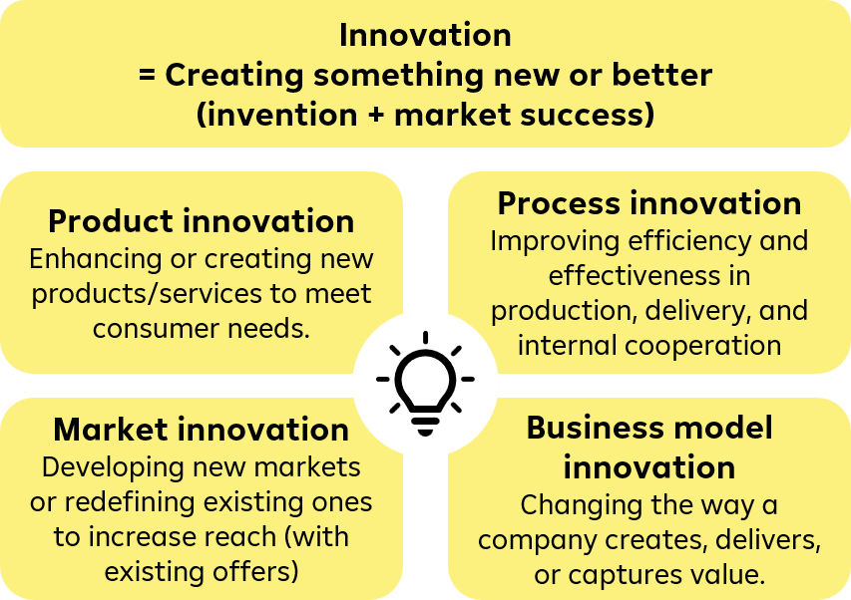
Innovation Terminology
Big picture of innovation
3
„Innovation is not my job. It is done by the innovation department.“

Slide 39
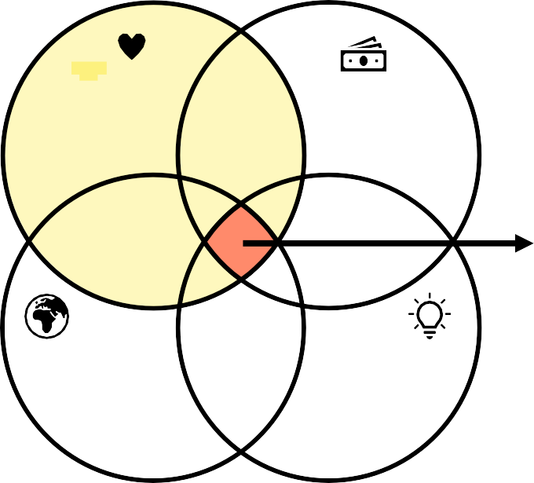


! Desire-ability (human)
Big picture of innovation
Are we actually soving someone‘s problem?
Is this worth pursuing and sustainable in the long run?
Innovation Starts With A Problem
Viability
(business)
INNOVATION SWEET SPOT
Taking the greater good into account, should it be built?
Integrity
(impact)
Feasibility
(technology)
Can it be built and can we actually build it?
4
„I have an idea, let’s implement it!“
It always starts with a problem
Never go without a business plan
You need iterations: Do not fall in love with your idea Try to decrease risk by gathering information
Prove your point

Slide 40


Success Factors of Innovation Projects
Big picture of innovation
Passion
Confidence and courage to proceed
Urgency
Feeling and proving the need to change
Challenge
Having a clear goal and scope
Teamwork
Diversity and collective
intelligence
Something New
e.g., new technology or solution
Focus & Perseverance Stay on track, do not stop at every hurdle, adapt
Empathy & Insights Know the target group and market
5
„We have started several projects on this topic, and it just does not work.“
Planning & Preparation
Project management skills

Slide 41
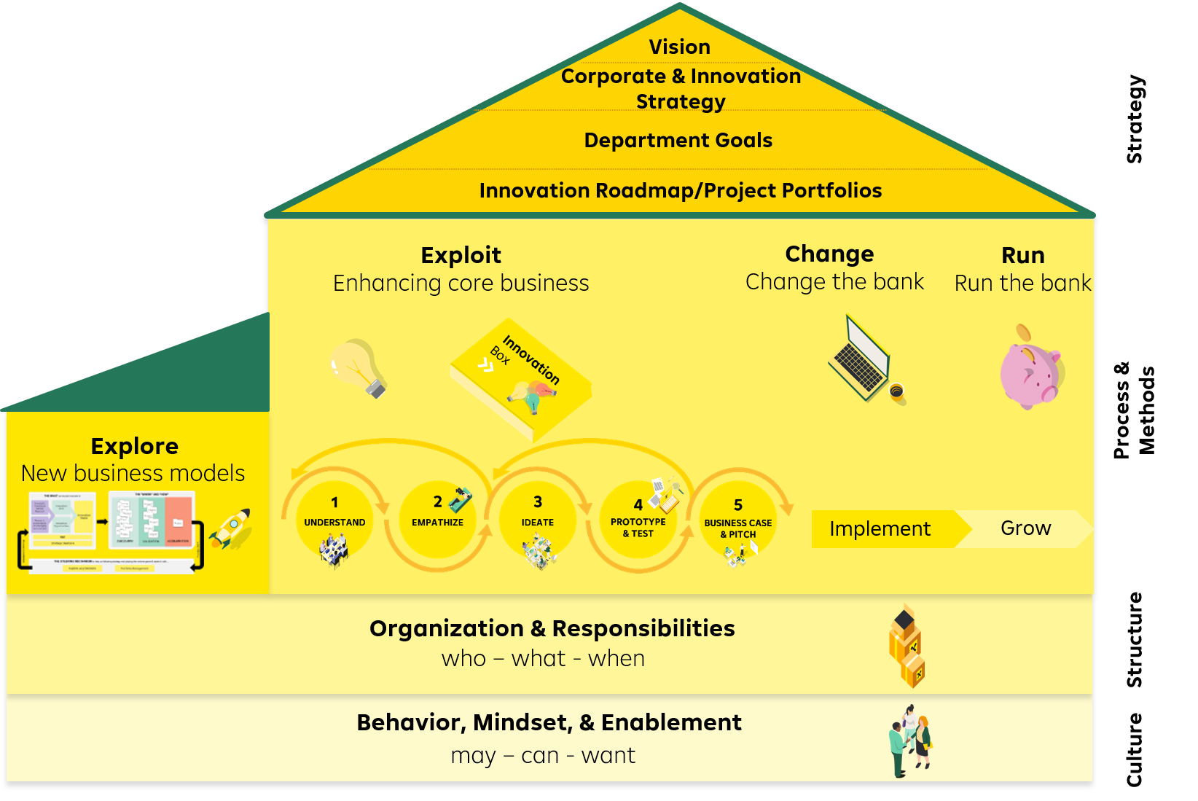

Corporate Innovation
Big picture of innovation
6
„Innovation means creativity and post its.“

Slide 42
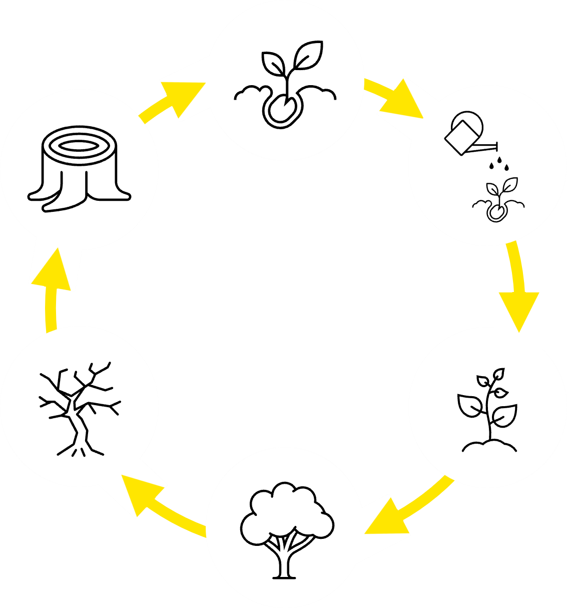
Big picture of innovation
Innovation is not a one-time project
IT IS A PROCESS

Slide 44


Slide 45


Innovation Culture

Slide 46
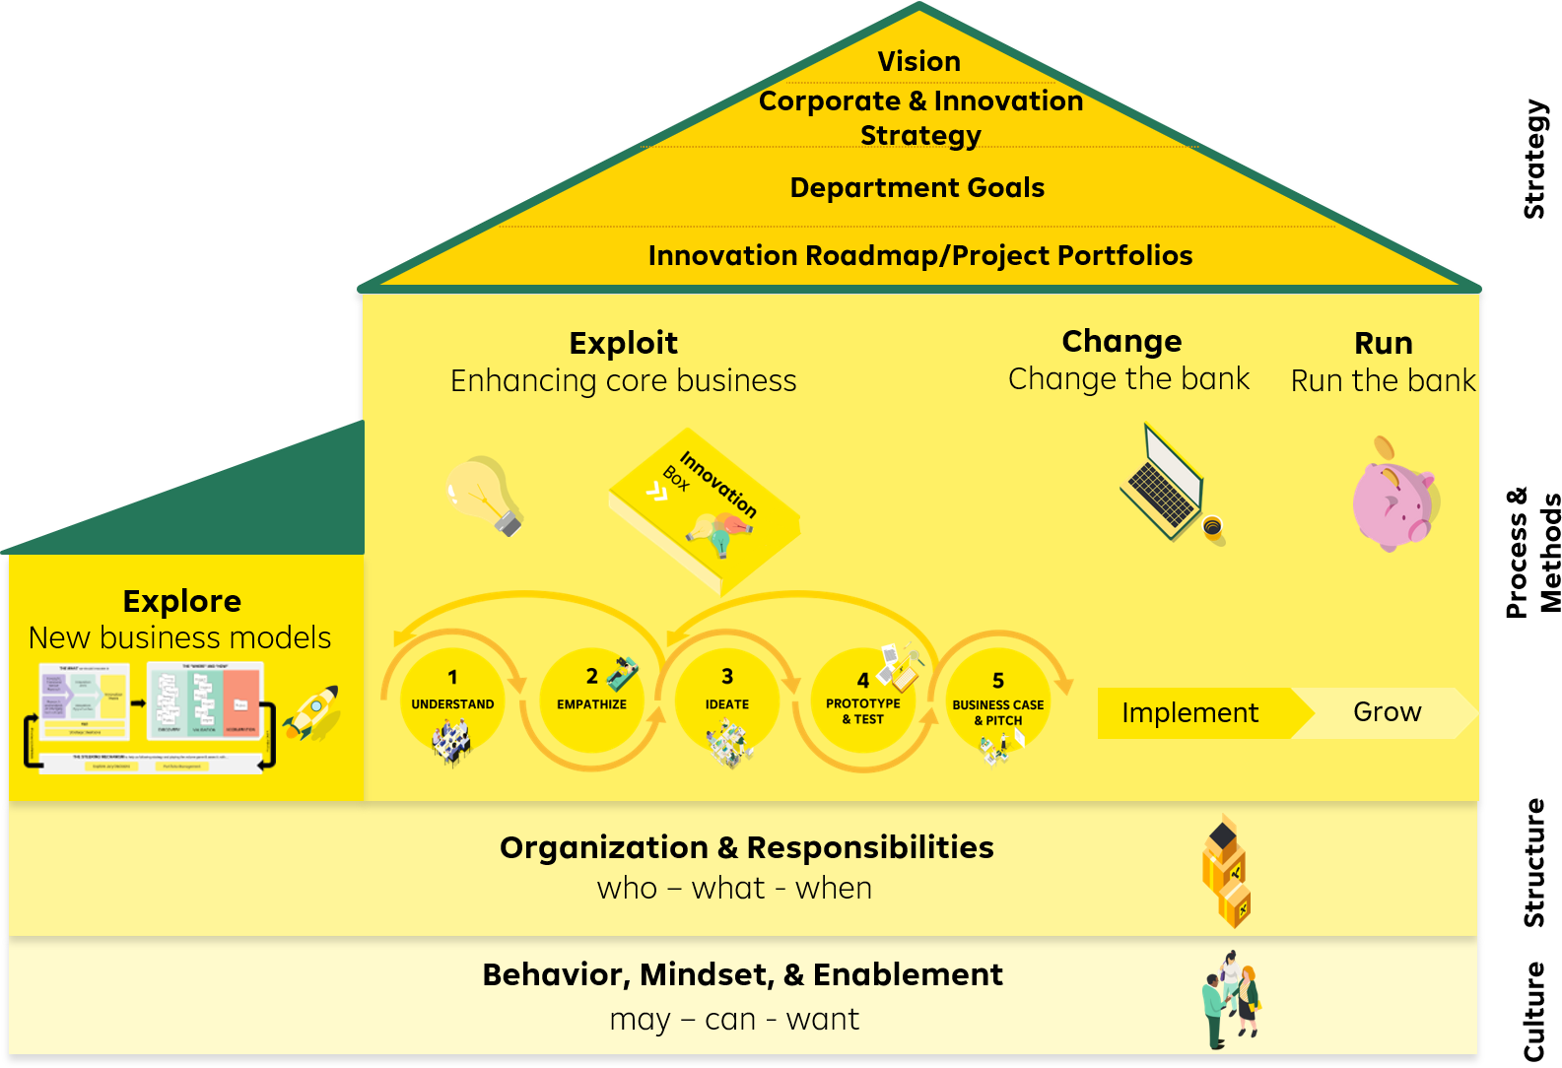
House of Innovation – the Foundation
Innovation Culture

Slide 47

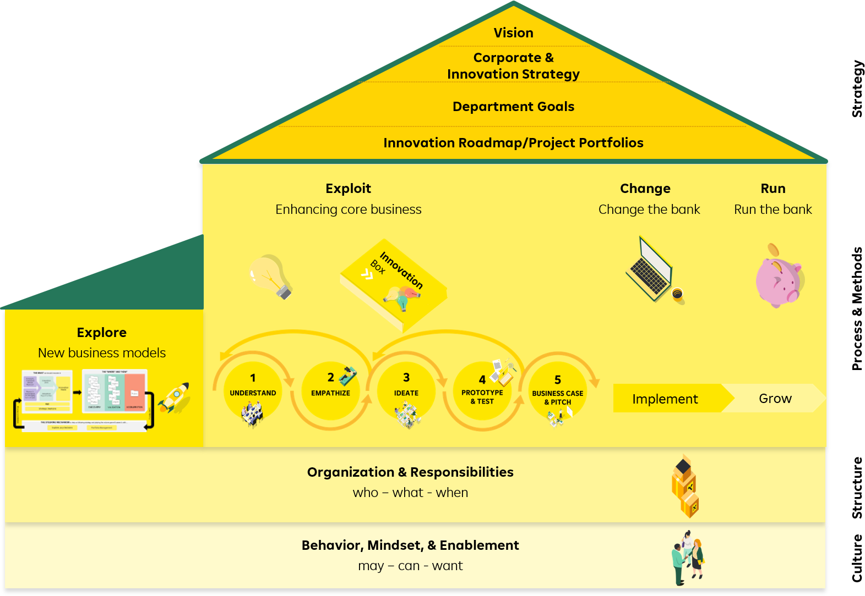









3 Pillars of Culture Work
Innovation Culture
Collaboration
Facilitation
Mindset

Slide 48


What is Culture in the first place?
Innovation Culture
Culture

Slide 49


„A tractor maker shouldn't tell me
how to build sports cars“
Innovation Culture
- Enzo Ferrari

Slide 50
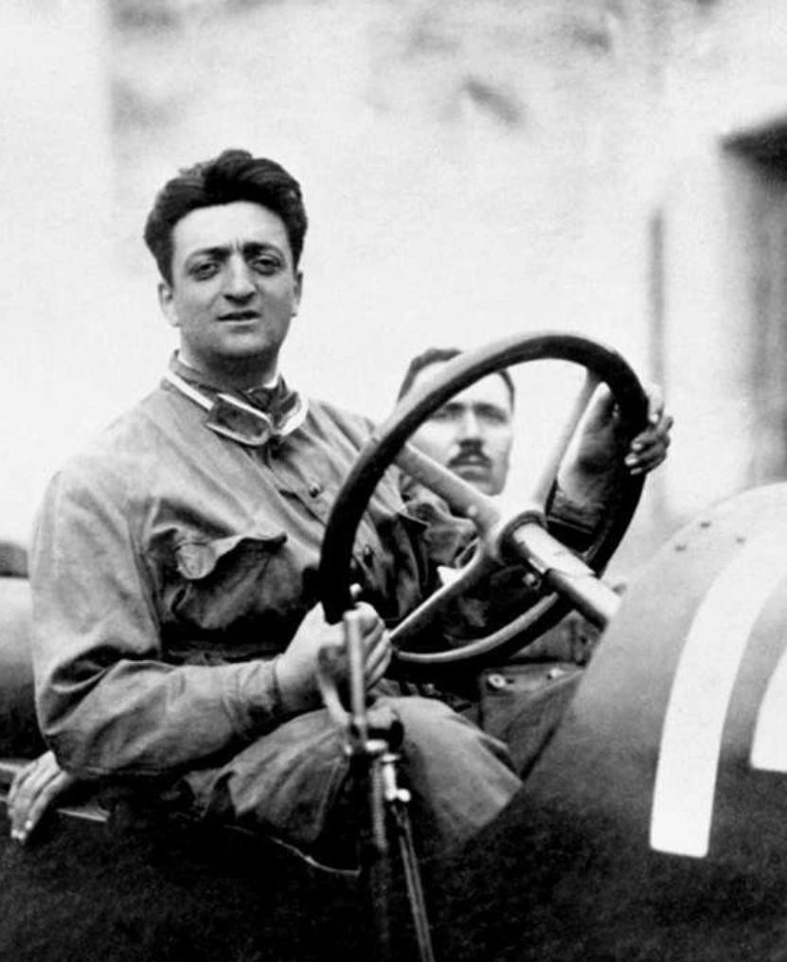

Innovation Culture

Slide 51


Key Messages
Innovation Culture
Lesson 1:
Your most annoying user might be your biggest asset
Lesson 2:
Innovation happens wherever people have drive, tools, and freedom to build it
Lamborghini Miura

Slide 52










Mindsets
Innovation Culture
Fixed Mindset
Growth Mindset
Innovation Mindset

Slide 53






Innovation Mindset…
Innovation Culture
"I stick to what I know." "This is too difficult!" "I made a mistake!”
“I give up!" "What if I can't do it?"
"I like to try new things." "I need time and effort." "I learn from this."
"I need to try a different approach."
"What goal am I actually pursuing?"
"I love problems!"
"I try different things until it works and keep learning in the process."
"I love iterating every week!" “It's okay if the goal changes."
Fixed
Mindset
Growth
Mindset
Innovation
Mindset
... means different attitudes in daily work.

Slide 54


Innovation Culture
Failure Culture

Slide 55
Innovation Culture
Fixed-mindset individuals dread failure because it is a negative statement on their basic abilities, while growth and innovation mindset individuals don't mind or fear failure as much because they realize their performance can be improved and learning comes from failure.
- Professor Carol Dweck (Stanford)

Slide 56


Learning Mindset
Innovation Culture
Failure = Learning opportunity
Fail fast and early
Who did this?
Learn fast and early
What happened?
How can we learn from it?

Slide 57













Four tips for an innovation mindset in your daily life
Innovation Culture
Curious & Together
Use a bird's-eye view
Embrace mistakes
Find next best step
Put yourself in situations that push you. Look for allies and foster collaboration.
Take a step back. Use metaphors that help you see the big picture and not get lost in the details.
Lead by example, stay committed, and see mistakes for what they are: Learning opportunities.
When overwhelmed, you don't need to solve everything, just find the next right step and take it.
!! Applicable starting today !!

Slide 58
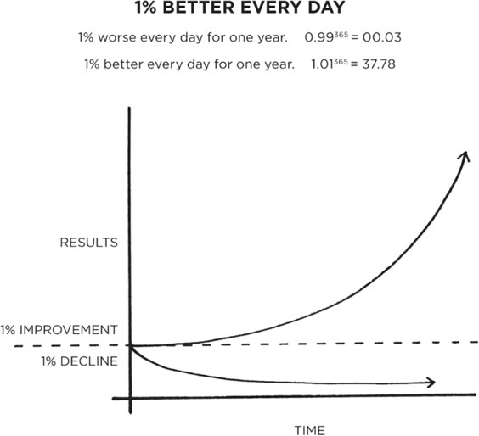


Culture by Disaster … or by Design
Innovation Culture
How can we build and establish habits for desirable change?
Improvement
Decline

Slide 59
Getting to Know Your Team
And Yourself…

Slide 60




COACH
Teaming
YOU
YOUR TEAM

Slide 61


Getting to Know Your Team
Teaming
A good team consists of diverse people and people who know each other
And themselves…

Slide 62
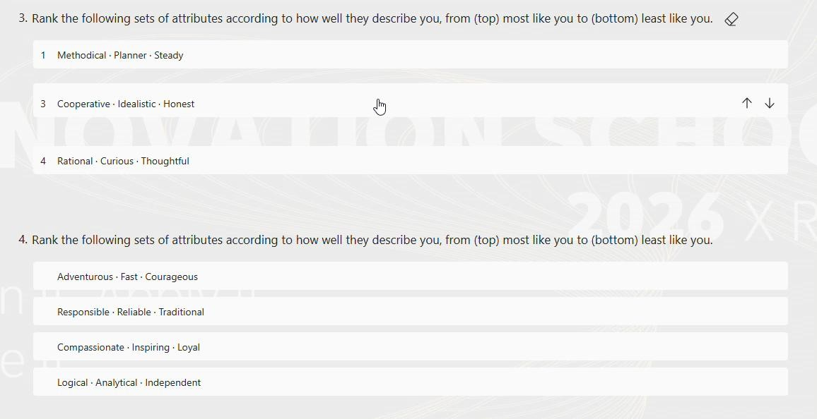
Do You Remember This?
Teaming

Slide 63
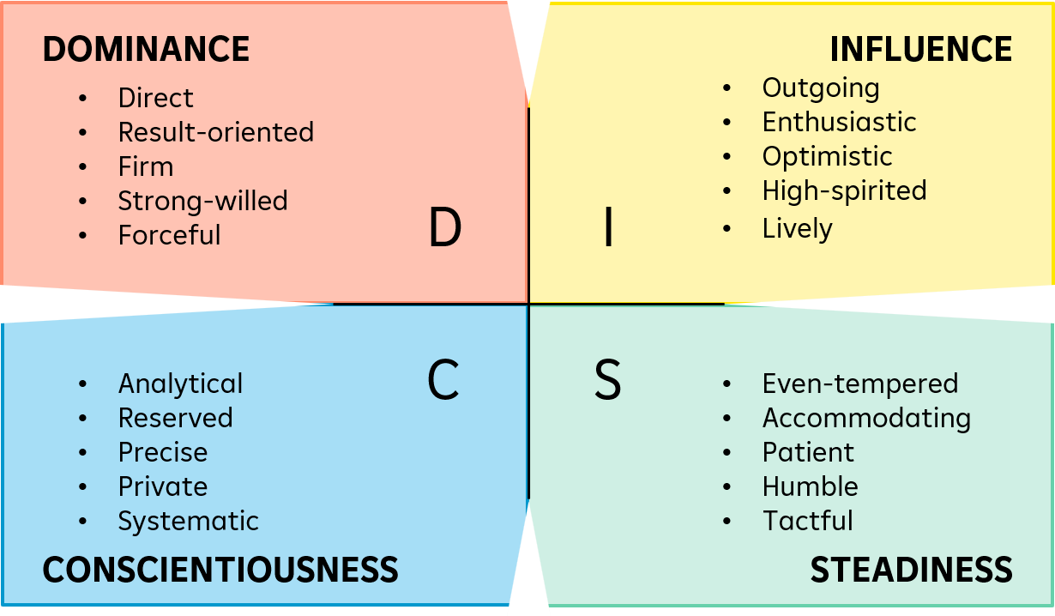
Getting to Know Yourself
Teaming
Results
Action
Enthusiasm
Challenge
Collaboration
Accuracy
Stability
Support

Slide 64
Lets Do This Together!
Teaming
Spontaneous Impulsive Quick
3
Methodical Planner Steady
2
Cooperative Idealistic Honest
1
Rational Curious Thoughtful
4
1 row at a time
Adventurous Fast Courageous
Responsible Reliable Traditional
Compassionate Inspiring
Loyal
Logical Analytical Independent
1 row at a time
2
3
1
4
Explorer
Dutiful Teacher Hardworking
Authentic Motivator Empathic
Intellectual
4
1
2
Problem Solver 3
1 row at a time
Curious
Loves Excitement
Inventive
Energetic Jokester Efficient
Makes Rules
Supportive Caring
Self-aware
Independent
2
Well-prepared 1
4
3
1 row at a time
Perfectionist
Strucured
System Thinker
Bold Witty
Risk-taker
Trustworthy Loyal
Likes Structure
Flexible Kind Imaginative
Theoretical Individualist Inventive
1 row at a time
3
2
1
4
ye1ll4ow
r9ed
gr9een
b1lu8e
AT LAST: SUM

Slide 65























Your Task: Come up with a coat of arms and a team name based on your discussions
Teaming
40
min
1. Find out:
Who is which type?
What do you have in common?
What is a big difference in your styles?
Check the descriptions on page 14!
2. Come up with
Your team name
Your coat of arms

Slide 66


Teaming

Slide 69

Energizer

Slide 70
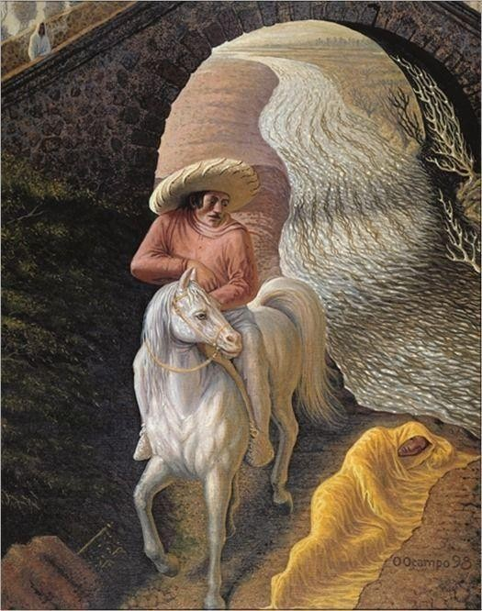
Energizer

Slide 71

Energizer

Slide 72

Energizer

Slide 73

Energizer

Slide 74
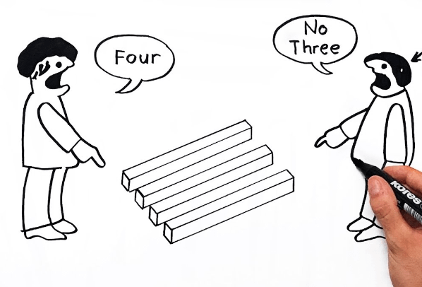
What Is Your Takeaway from This Exercise?

Slide 75
RBI Innovation Process

Slide 76
„Wow, now THAT is really solving a pain point the right way!“
RBI Innovation Process
„Finally, someone understands my user needs!“

Slide 77

Imagine you want to hang up a picture on the wall.
RBI Innovation Process

Slide 78



People don‘t want to buy a quarter-inch drill. They want a quarter-inch hole.
RBI Innovation Process
- Theodore Levitt, Harvard Professor
Think product
Think customer

Slide 79



Product focus: How can we (further)
RBI Innovation Process
Customer focus: I want to get from A to B
Think Product
Think Customer

Slide 80
The Design Thinking Process
RBI Innovation Process
Understand
Empathize
Synthesize
Ideate
Prototype
Test
Challenge
HMW
Problem Space
Solution Space

Slide 81
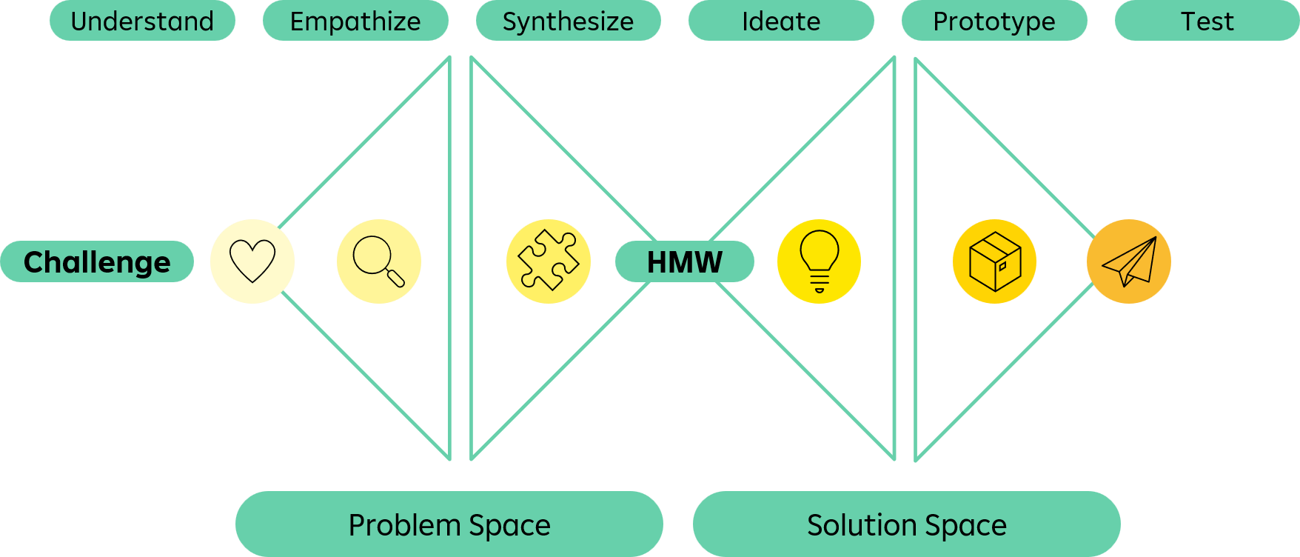
Design Thinking as Toolbox and Mindset
RBI Innovation Process
Skip
Skip
12 weeks
2 day workshop

Slide 82
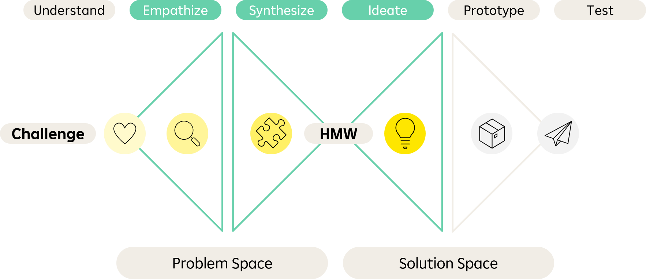
Design Thinking as Toolbox and Mindset
RBI Innovation Process
Do a “nagging” session to collect all problems and pains currently connected with a process or service
Do an ideation workshop on a topic you are stuck with using a creativity method

Slide 83
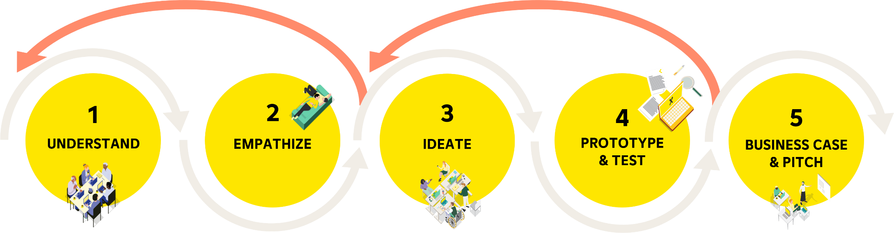
Our Process
RBI Innovation Process
Follow Design Thinking to avoid common innovation mistakes
Design Thinking
is a non-linear, iterative process that teams use to understand users, challenge assumptions, redefine problems, and create innovative solutions to prototype and test.
Iterate!
Iterate!

Slide 84











How We Are Going to Work with AI
RBI Innovation Process
Observations and Importance of
Innovation School
AI
Implementation
Fast AI-Progress
AI in Innovation
Manual Skills Matter
AI as Aid
AI is advancing rapidly with new daily capabilities.
AI supports every step of the innovation process.
Knowing manual steps is key to guiding and judging AI.
AI will assist only after manual groundwork is done.

Slide 85
STEP 1
Understand
RBI Innovation Process

Slide 86





RBI Innovation Process
RBI Innovation Process
1
UNDERSTAND
2
EMPATHIZE
3
IDEATE
4
PROTOTYPE & TEST
5
BUSINESS CASE & PITCH

Slide 87
RBI Innovation Process
RBI Innovation Process
1
UNDERSTAND
2
EMPATHIZE
3
IDEATE
4
PROTOTYPE & TEST
5
BUSINESS CASE & PITCH

Slide 88








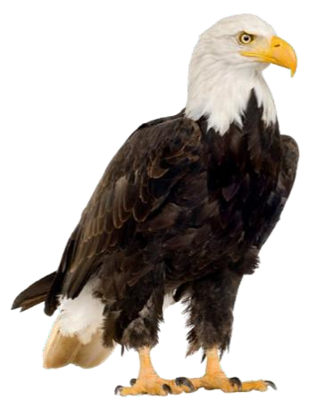


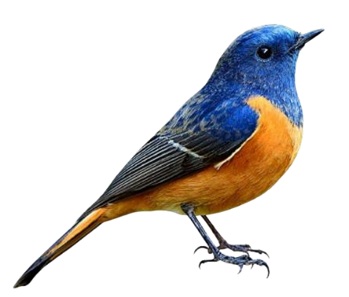
1
Understand
Remember
We might say the same thing but have different things in mind.
Theory

Slide 89



Problem Space
1
Understand
Theory

Slide 90
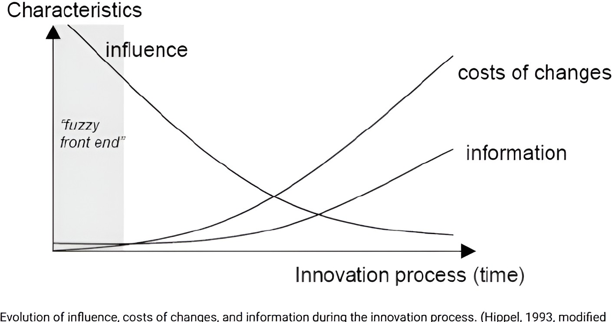
In This Process Information Is Everything…
1
Understand
Theory

Slide 91

Slow at the Beginning – Fast at the End
1
Understand
Theory

Slide 92
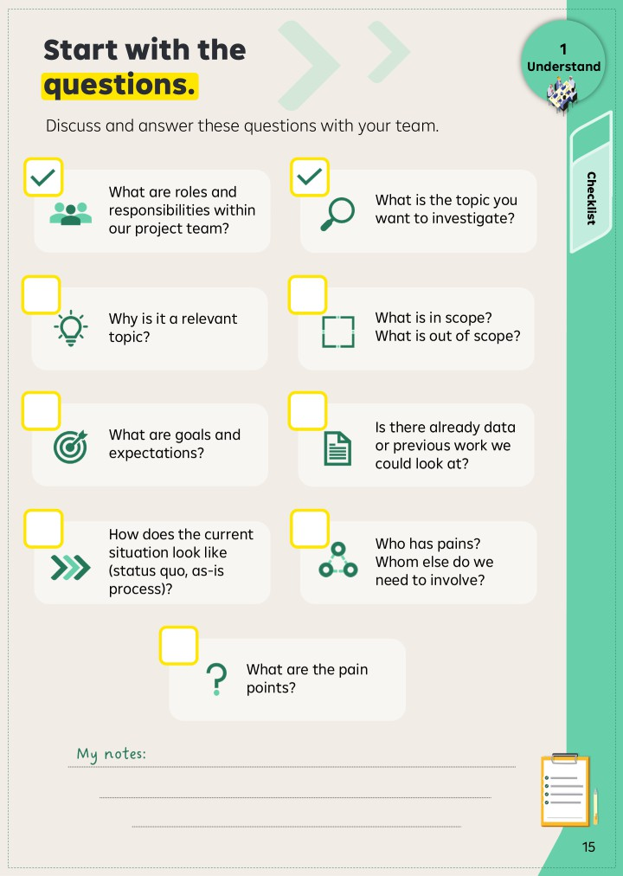

Your Checklist for Step 1: Understand
1
Understand
Theory

Slide 93
Your Checklist for Step 1: Understand
1
Understand
Theory

Slide 94
Understand Your Stakeholders
1
Understand
Who is the target group or user?
Who is part of the process?
Who might be involved or affected? Also,
indirectly?
Who is interested in it?
Who pays for it?
Theory

Slide 95
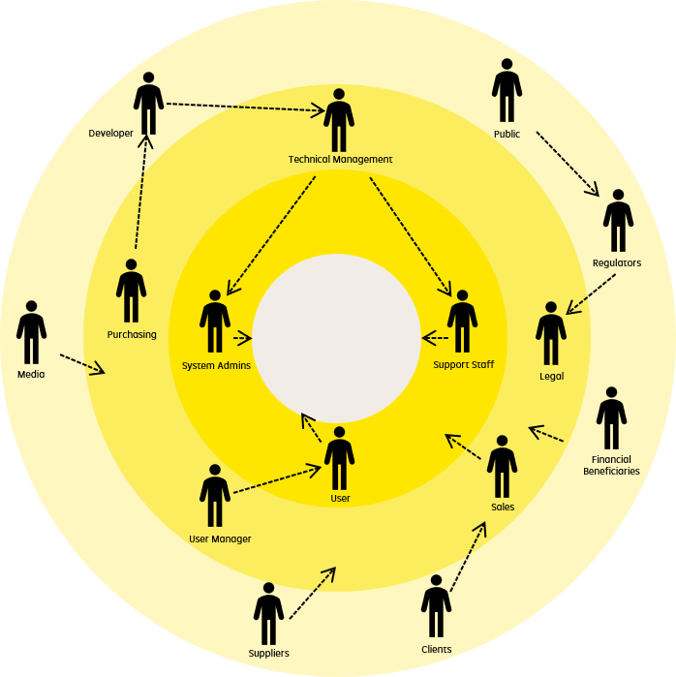
Understand Your Stakeholders
1
Understand
Meet their needs
Manage closely
Theory
Take into
account
Keep
informed
Power/Influence
Level of stakeholder interest

Slide 96
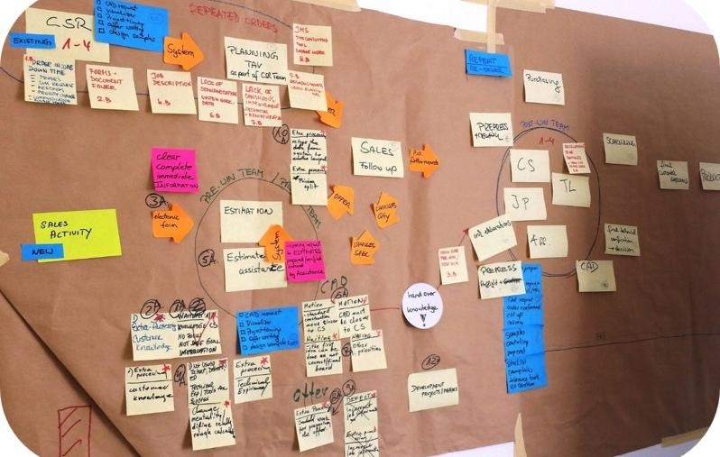
Process Mapping to Define the Scope
1
Understand
Initial Screening
versus Exclusion Lists**
1.
Onboarding/ Minerva
Theory
ESG Critical
Classification with guidance of pre-defined parameters
Scope
Relationship Manager
2.
Business Decision
Via Investment Committee OR Relationship Manager
Relationship Manager
ESG
Critical
ESG not
Critical
ESG Expert Opinion
Incl. Reputational + ESG Impact
Sustainable Finance
1st line of defense
2nd line of defense
Environmental Risk
Assessment
Incl. ESG Credit Risk
3.
Risk Analyst

Slide 97
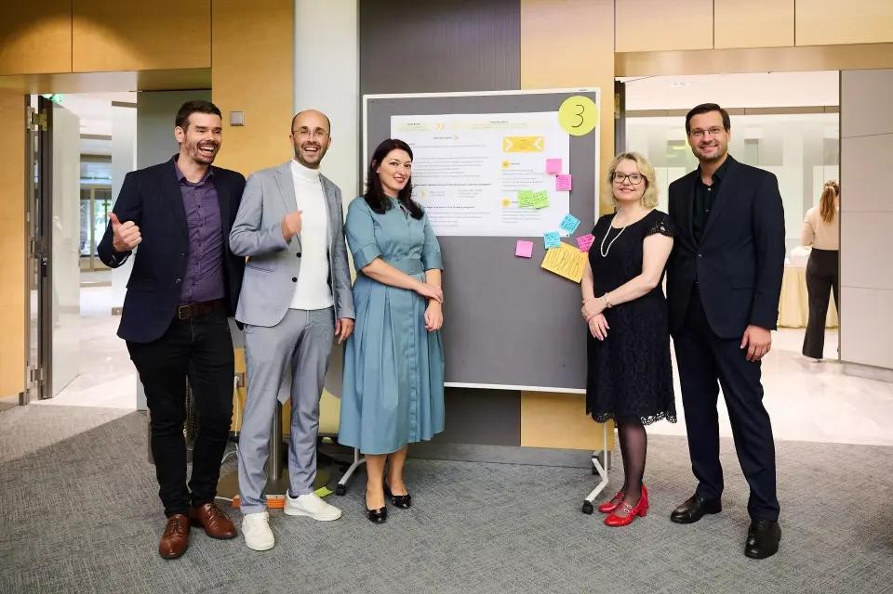


Legal Documentation Assistant
1
Understand
The project aimed to explore how AI could support experts in reviewing and analyzing loan contracts and legal documentation
Understand-Step Process mapping based on multi-user interview analysis
RBI Case Study
Aha-Moment
Limited standardization prevented full automation, so the team prioritized the most impactful process
steps

Slide 98
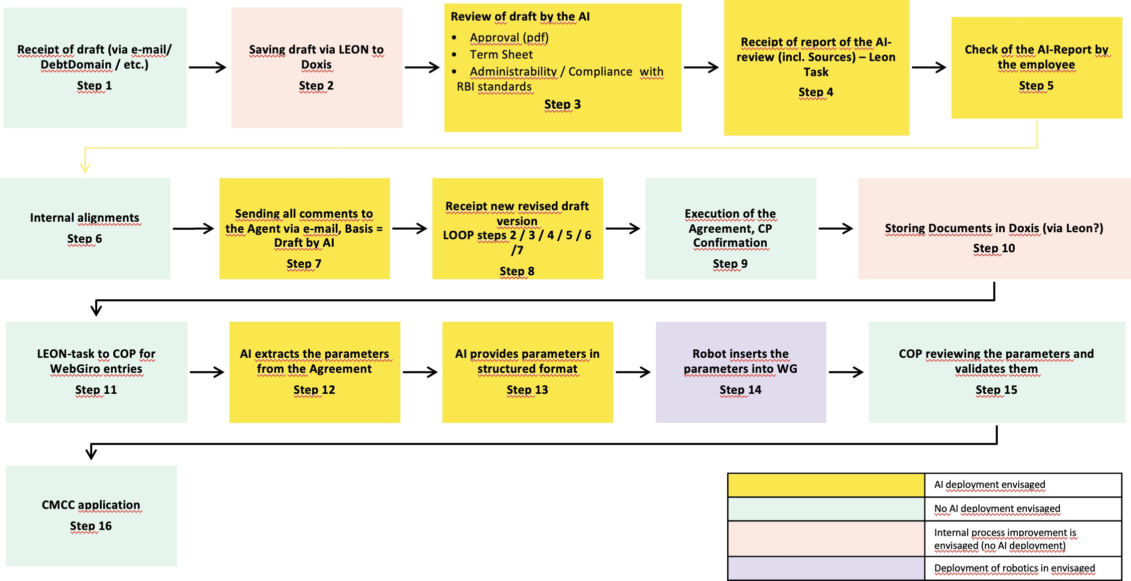
Legal Documentation Assistant
1
Understand
RBI Case Study

Slide 99
Your Task: Finish Understanding and Scoping
1
Understand
Recap (10 min):
Review and adapt the problem description to your needs
(challenge what is there!)
Discuss the scope
Lay out what you know and bring your collected data to the table
Always list open questions
45
min
Work on it
Process and Stakeholder Mapping (35 min):
Sketch process/user journey as you think it looks right now
List users and additional stakeholders

Slide 100











Understand in a Nutshell
1
Understand
Mindset
Let’s clarify and align before we run
Goals
Tools
WorkSounmitmary
Create a common understanding with team and management
Checklist: Understand Phase
Process Mapping
Understand the current state and lay out what you know
Stakeholder Mapping
Identify the target audience, stakeholders and their potential pains
Desk Research
Organize your next steps

Slide 101
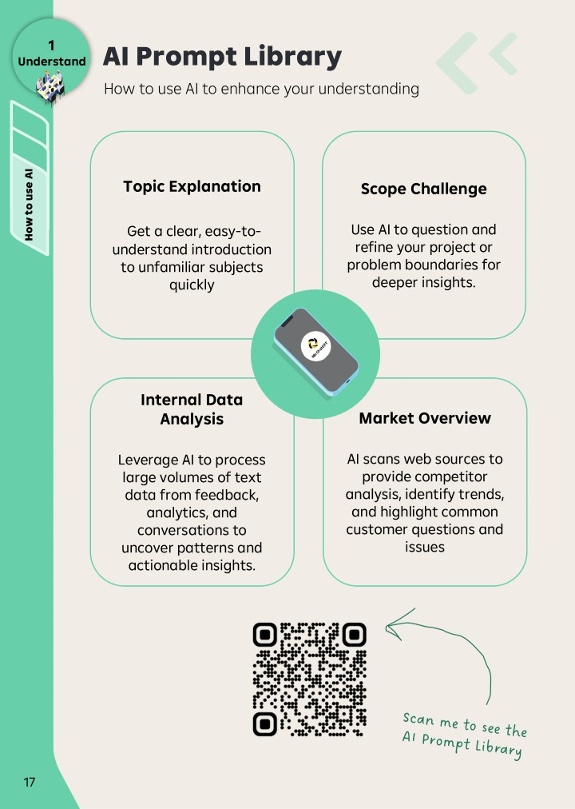
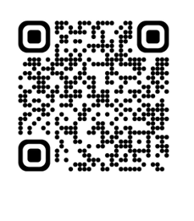
Prompt Library
1
Understand

Slide 102



1
Understand
Topic Explanation
Get a clear, easy-to-understand introduction to unfamiliar subjects quickly
Scope Challenge
Use AI to question and refine your project or problem boundaries for deeper insights.
Work oSunmitHmoawryto use AI
Internal Data Analysis
Leverage AI to process large volumes of text data from feedback, analytics, and conversations to uncover patterns and actionable insights.
Market Overview
AI scans web sources to provide competitor analysis, identify trends, and highlight common customer questions and issues

Slide 103













Introduction to Habits
1
Understand
Trigger
In which situation would you try to use the habit?
Identify a specific situation, event, or moment when you would apply this new habit
Desirable step
What exactly will you do in this situation?
Define one simple and concrete behavior you can perform in that situation
Work oSunmitHmoawryto usHeaAbIits
Habit-stacking
How can you make it stick?
Link the new habit to an existing routine or activity so it becomes a natural part of your workflow

Slide 104


1
Understand
Trigger
An idea is brought to you by a colleague or your manager
Work oSunmitHmoawryto usHeaAbIits

Slide 105


1
Understand
Desirable Step
Before starting to work on it, you insist on filling out a small project brief together, answering some “nasty” questions:
What problem would it solve and for whom?
Do we know how big the problem is? How often does it happen?
What would we consider in or out of scope? What is unknown or still to be found out?
Work oSunmitHmoawryto usHeaAbIits

Slide 106


1
Understand
Habit-Stacking
You add these questions into the Jira Idea Board that your team anyway uses
Work oSunmitHmoawryto usHeaAbIits

Slide 107


Take your time and note down habits that you are planning to immediately implement after Innovation School regarding this first step.
1
Understand
Work oSunmitHmoawryto usHeaAbIits
Page 18

Slide 108
1
Understand

Slide 111



Customers want digital-first experiences.
Energizer
Fact:
Assumption:

Slide 112
Data tells us everything we need to know.
Energizer
Fact:
Assumption:

Slide 113
Energizer
In 2025, RBI recorded a consolidated profit of € 1,371 million.
Fact: Assumption:

Slide 114
People are rational decision makers.
Energizer
Fact:
Assumption:

Slide 115
Energizer
Customers don’t want to go to the branches anymore.
Fact: Assumption:

Slide 116
Employees understand customer needs.
Energizer
Fact:
Assumption:

Slide 117
What is your takeaway from this exercise?

Slide 118
STEP 2.1
Empathize –
Research Preparation
RBI Innovation Process

Slide 119

RBI Innovation Process
RBI Innovation Process
1
UNDERSTAND
2
EMPATHIZE
3
IDEATE
4
PROTOTYPE & TEST
5
BUSINESS CASE & PITCH

Slide 120
RBI Innovation Process
RBI Innovation Process
1
UNDERSTAND
2
EMPATHIZE
3
IDEATE
4
PROTOTYPE & TEST
5
BUSINESS CASE & PITCH

Slide 121



2.1
Research Preparation
It is about perspective
Theory

Slide 122
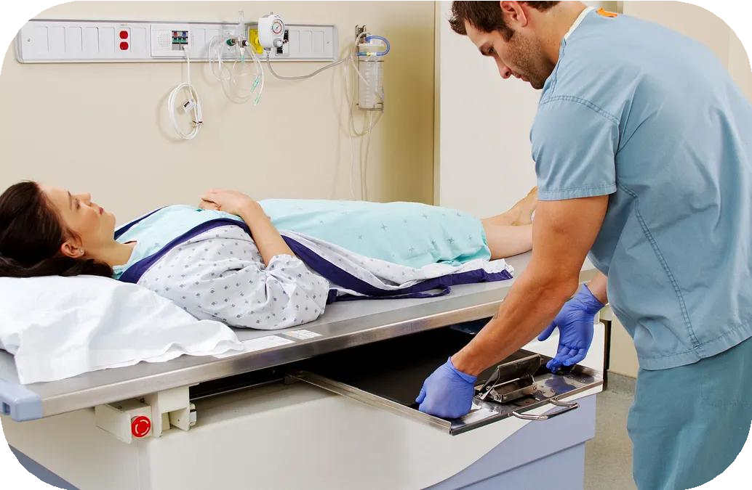

2.1
Research Preparation
What we see:
What the user sees:
Theory

Slide 123
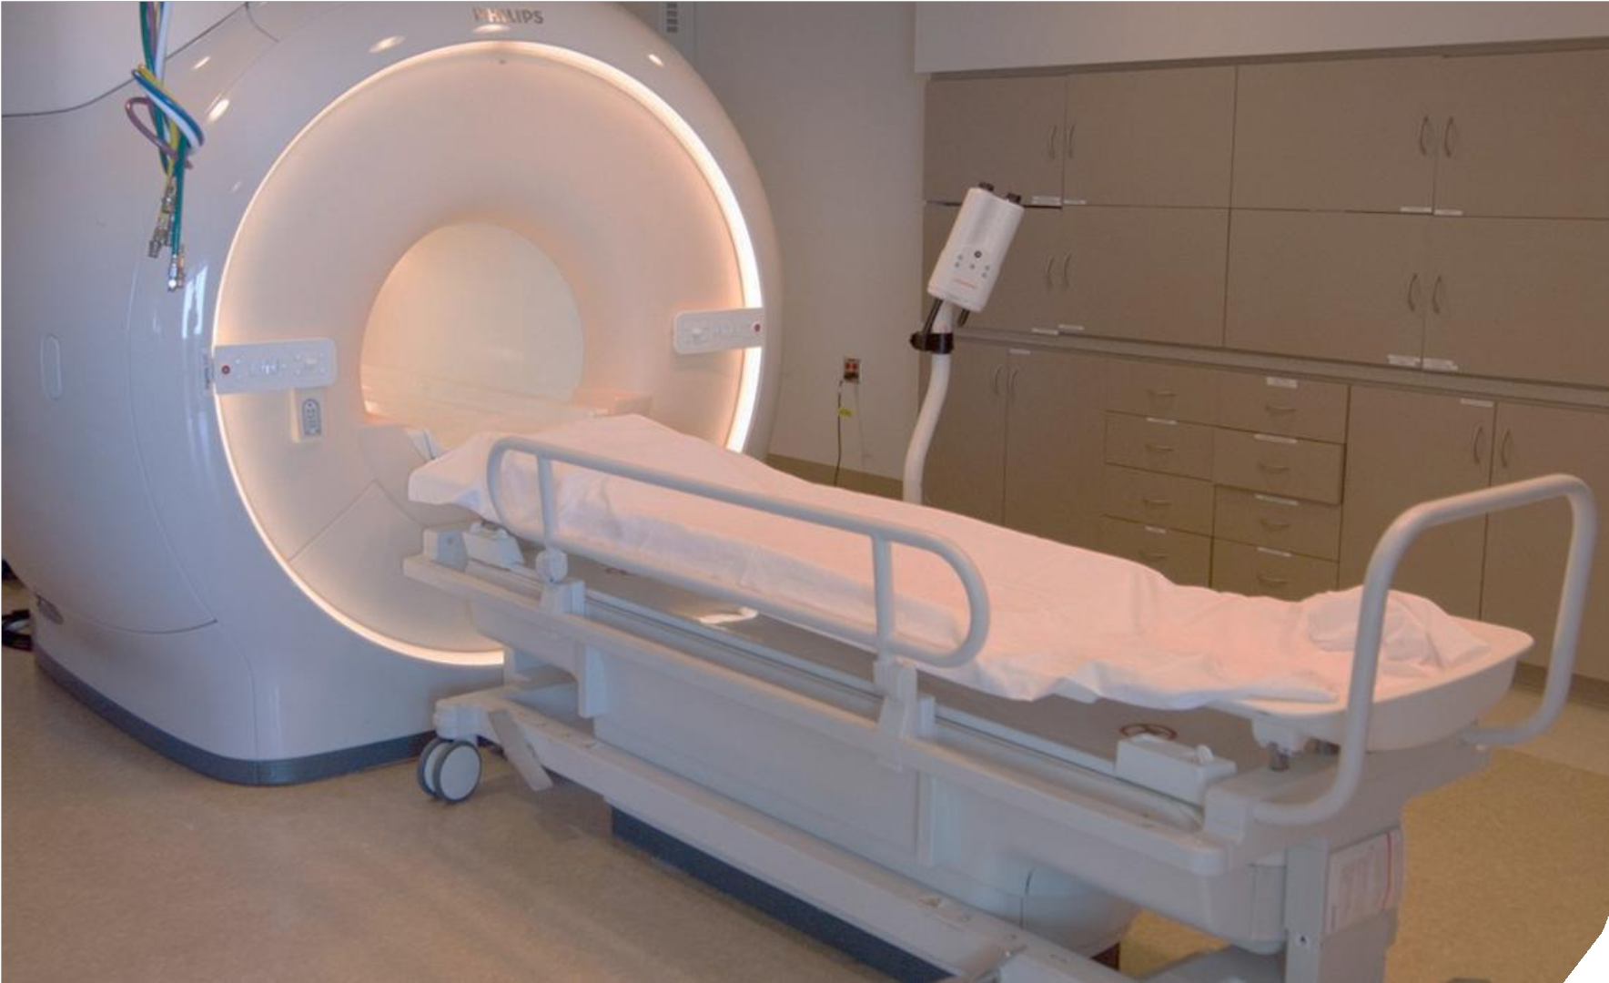
2.1
Research Preparation
Theory

Slide 124

2.1
Research Preparation
How might we find a way for children not to scream during an MRI scan?
Theory

Slide 125
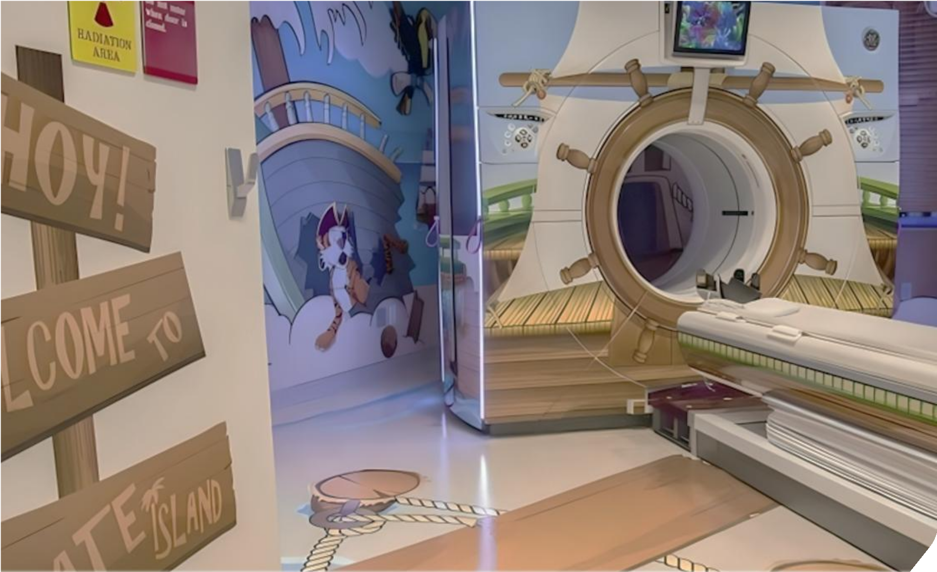
2.1
Research Preparation
Theory

Slide 126
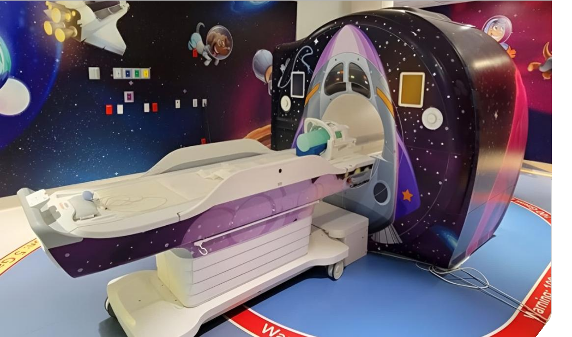
2.1
Research Preparation
Theory

Slide 127
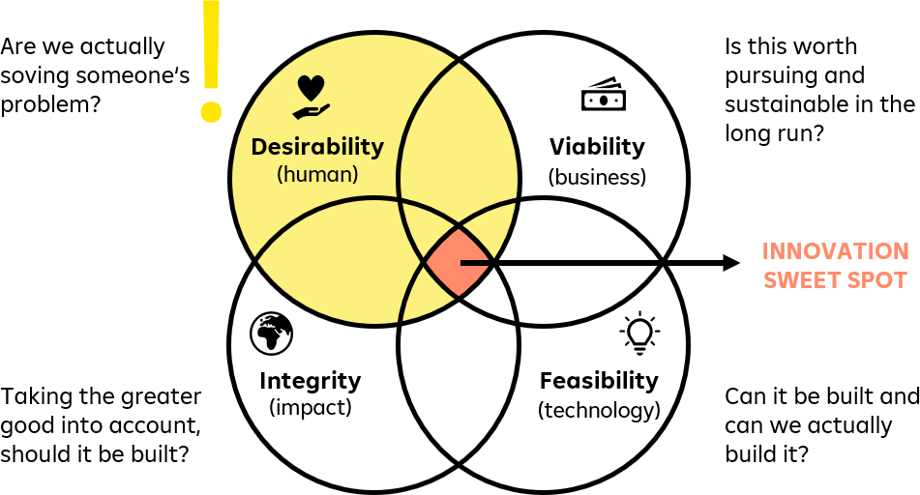
Customer Centricity and Understanding
2.1
Research Preparation
Theory

Slide 128
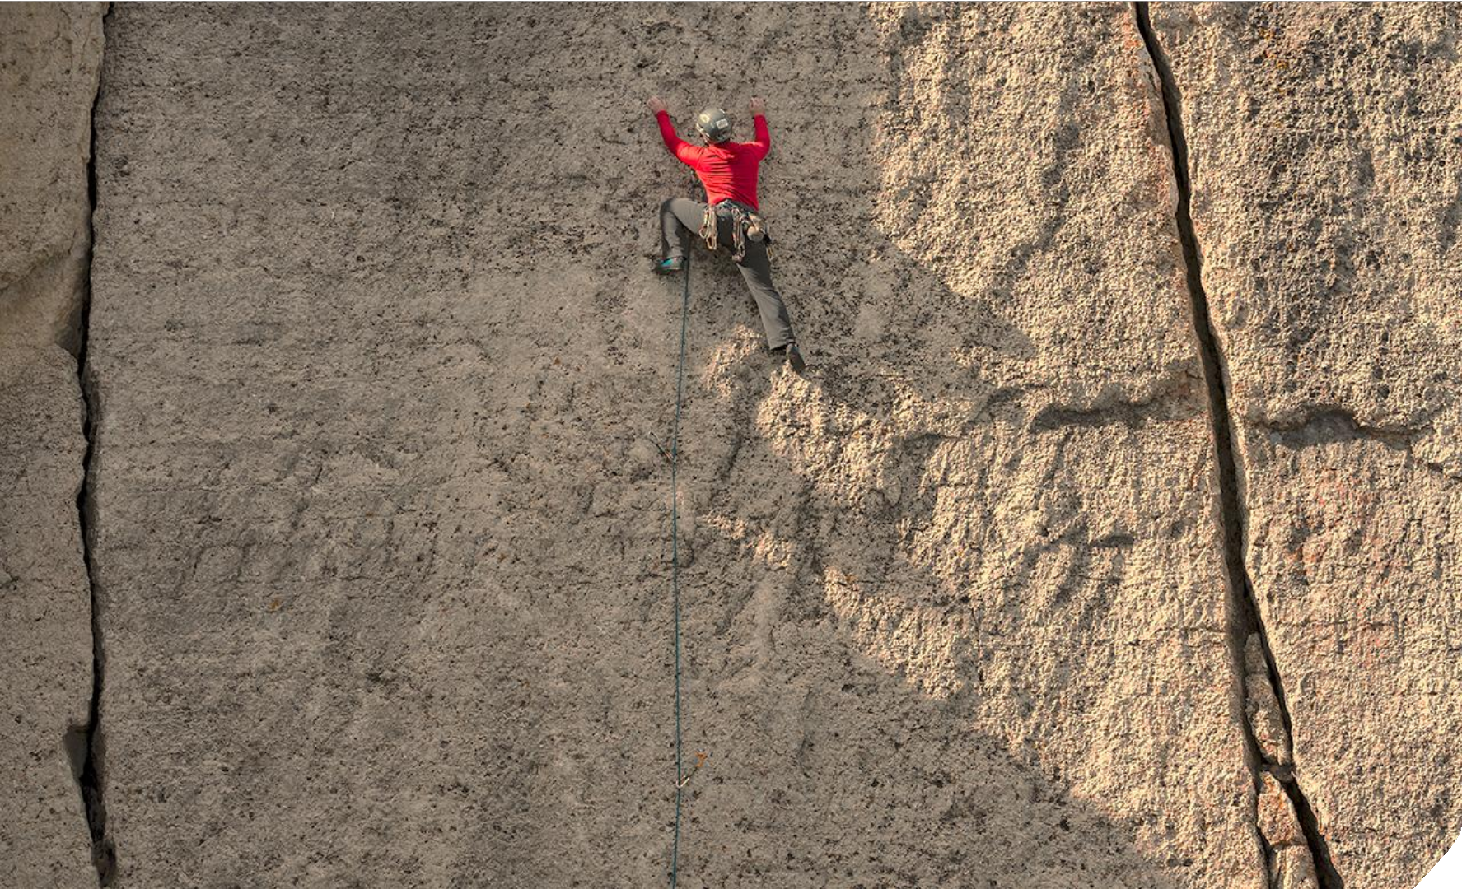
2.1
Research Preparation
Theory
Hypotheses

Slide 129

















Hypotheses-Based Learning
2.1
Research Preparation
When starting a project, we make a lot of assumptions, some more critical than others:
Assumption about desirability (Do users want/need it?)
We believe that users feel the pain that…
We believe that customers are looking for...
We believe we can retain customers by...
Assumption about feasibility (Can we do it?)
We believe that we have the capability to....
We believe that we can partner up with...
We believe we can develop XYZ until...
Assumption about viability (Is there a viable business case?)
We believe that users will use it for the price....
We believe that we can achieve sufficient savings...
We believe that we can raise customer satisfaction by...
We believe that the costs will be...
Theory

Slide 130
Hypotheses-Based Learning
2.1
Research Preparation
What is a hypothesis?
A hypothesis is an assumption formulated in a way that can easily be tested.
Therefore, it needs to be:
Theory
Testable
It can be shown as true (validated) or false
(invalided)
Precise
Who should do what? When?
Distinct
It describes one specific element.
1
2
3
Example:
"We believe that when discussing the situation XYZ with the target audience, 8 out of 10 will illustrate that they have the pain point of XYZ."

Slide 131
Hypotheses-Based Learning
2.1
Research Preparation
Which hypothesis should I start with?
Theory
Start with your “most critical hypothesis”.
This hypothesis needs to be true, for your project to succeed, AND you do not have concrete evidence yet that it is true.

Slide 132









Different Ways to Check Your Hypotheses
2.1
Research Preparation
Theory
Deep data analysis
Customer journey mapping/ Internal process mapping
Quantitative Research:
Qualitative Research:
Market analysis and market
research (also analogous fields)
User interviews &
Observations

Slide 133







Hypotheses Mapping
2.1
Research Preparation
Hypotheses
Research Method
Success Criteria
Theory
We believe that …
To verify that we will …
We are right if …
Customers visit branches because they prefer face-to-face service over digital channels
Conduct 10-15 customer interviews with recent branch visitors
At least 70% of interviewed customers state that personal interaction is their main reason for visiting
…
…
…
…
…
…

Slide 134
2.1
Research Preparation
Theory
How do I get the user insights?
Who should I talk to?

Slide 135

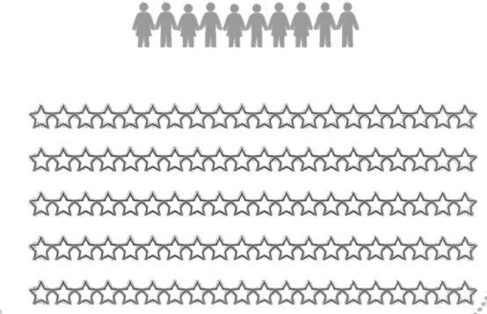
Research
2.1
Research Preparation
Quantitative research
Qualitative research
Theory
Big data, past oriented, superficial
Big insights, future oriented, empathetic
Long-term you
need both
Are our learnings actually true?
Are our learnings
consistent?

Slide 136


2.1
Research Preparation
Qualitative Research
Shadowing is a qualitative research method that involves following a user as they engage in their daily activities to gain insights into their behaviors, routines, and interactions with products or services.
User Observation is a qualitative research method that involves broader method including watching users interact with a product or service, often in a controlled setting or during specific tasks.
Theory

Slide 137
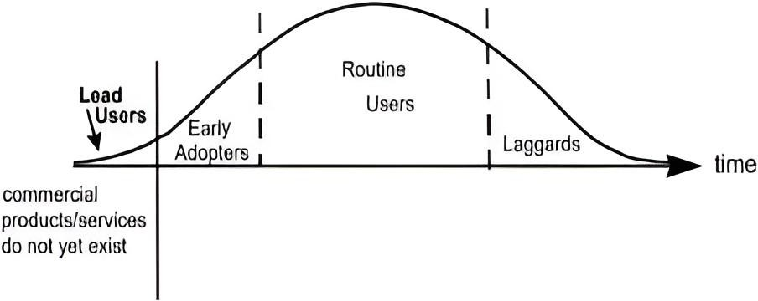
2.1
Research Preparation
Qualitative Research
Lead Users / Extreme Users
Use the actual products/services/processes heavily and therefore profit from improvement
Theory
Might be dissatisfied with actual product/service/process
Have pain points that others might not yet feel
Might already have ideas on how to improve products/services/processes
Are valuable insight sources and co-creators in innovation

Slide 138

2.1
Research Preparation
Qualitative Research
New Normal With Lead Users / Everybody Else
Theory
Lead users

Slide 139
2.1
Research Preparation
Theory
Example:
Observation at construction site: Where are challenges and bottlenecks?

Slide 140
2.1
Research Preparation
Theory
How do I find the right experts and users?

Slide 141





Finding Experts & Specific Users – Asking Around
2.1
Research Preparation
Pyramiding is a search process based upon the idea that people with a strong interest in a topic or field tend to know people more expert than themselves
Theory
We have a guy for that!

Slide 142
2.1
Research Preparation
Theory
Example: Looking for senior expert on AI training

Slide 143
2.1
Research Preparation
Theory
Which questions do we need to ask?
What do we need to prepare?

Slide 144

























Before the Interview
2.1
Research Preparation
Theory
1. Define
objectives
2. Define target audience
3. Prepare
questions
4. Choose the
right format
5. Set up logistics (Who goes where?)
6. Create a comfortable environment
7. Explain the
purpose, data usage, and obtain consent
8. Decide how you will take notes or record responses

Slide 145
Avoid Asking Biased Questions
2.1
Research Preparation
Biased (Leading) Questions
Unbiased (Explanatory)
Questions
Theory
“How difficult is it for you to manage your time?”
“Can you wwaallkk mmee tthhrroouugghh a typical day?”
“Do you get frustrated when the process takes too long?”
“HHoowwddooyyoouuuususuaalllyly feel about the process?”
“Would you say you need a better way to organize your tasks?”
“HHoowwddooyoyuoucucrurrerenntltyly keep track of what needs to be done?”
“Is iitt hard for you to find information when you need it?”
“Can you tetellllmmeeaabboouutt aa ttiimmeewwhheenn you needed certain information?”

Slide 146

PCO Process for Changing Working Hours
2.1
Research Preparation
The PCO team wanted to improve and ideally digitize the way of changing working hours for employees since the process was seen as cumbersome.
Understand-Step
Interviews with employees and managers.
RBI Case Study
Aha-Moment
Managers and employees saw no major issues or delays and liked the human touch, only asking for more transparency.
The real problems mainly affected PCO and background stakeholders, shifting the focus for a solution.

Slide 147
Your Task: Prepare Research Phase
2.1
Research Preparation
75
min
Evaluate your Problem Description by searching
for underlying assumptions
Write down current assumptions/questions on Post-its
Using your gut instincts: which 2-3 hypotheses are most critical to validate right now
Define how to test the hypotheses
Prepare interview questionnaire
Work on it
•
Schedule interviews for slot 09:45-10:50

Slide 148







Research Preparation in a nutshell
2.1
Research Preparation
Mindset
Stay flexible, hypothesis-driven,
but not hypothesis-blinded and focus on learning
Work oSunmitmary
Goals
Tools
Clarify what you want to learn
before talking to users
Checklist: Empathize Research
Preparation
Turn assumptions into hypotheses
Hypotheses Map
Define how to check hypotheses
Open-ended, semi-structure
interview guideline
Define who you need to interview and prepare a non-biased guideline
Different research techniques

Slide 149
AI for Research Preparation
2.1
Research Preparation
Hypothesis Formulation
AI helps you clearly define and structure
testable hypotheses.
Questionnaire Bias Check
AI reviews your questions to ensure they
are unbiased and neutrally phrased.
Work oSunmitHmoawryto use AI
Semi-Structured Questionnaire Creation
AI assists in drafting a flexible questionnaire aligned to your hypotheses.
User Simulation
Based on extensive customer data, AI can create a virtual user to simulate and explore customer interactions.

Slide 150

2.1
Research Preparation
Trigger
Whenever you want to improve a process or work on a new idea, Whenever there are 2 different opinions in a room
Work oSunmitHmoawryto usHeaAbIits

Slide 151

2.1
Research Preparation
Desirable Step
Schedule at least 1 meeting with an “outsider” expert or user to get a different and neutral perspective
Work oSunmitHmoawryto usHeaAbIits

Slide 152

2.1
Research Preparation
Habit-Stacking
Make this part of your project process
Work oSunmitHmoawryto usHeaAbIits

Slide 153
2.1
Research Preparation
3
min
Take your time and note down habits that you are planning to immediately implement after innovation school regarding this step
Reflection Work oSunmitHmoawryto usHeaAbIits
Page 22

Slide 154
2.1
Research Preparation

Slide 155








Reflection time
CONGRATS!
First Day Nearly Done

Slide 156


Why reflections matter
Reflection
Remembering ≠ Noticing

Slide 157
















Learning Transfer
Reflection
Imagine an anthropologist entered this room today.
They have never worked at RBI. They only observed us for one day.
What would they note down about how we worked today?
Mindset
Collaboration
Facilitation
How were people thinking today?
How were people working together today?
What helped create this experience today?
page 23

Slide 158
What is one small thing
you could bring into your own environment next week?
Reflection

Slide 159
Closing Our First Day in Budapest

Slide 160
Closing

Slide 161
What We Did Today
Closing
Online
Wed | 30.09.
09:00
Welcome
Innovation Challenge
Learning Transfer Individual Homework Closing
12:30
Budapest
Online
Wed | 04.11.
09:00
Welcome
Key Takeaway Presentation for Line Managers
Learnings
Reflection Closing 12:30
Follow Up
Wed | 15.12.
09:00
Welcome
Personal & Team Check-In
Alumni Meetup
Reflection Closing 11:00
Tue | 13.10.
08:30
Opening
Innovation Theory
Teaming Lunch Break
Wed | 14.10. Thu | 15.10. Fri | 16.10.
09:00 09:00 09:00
Workmode Reflection
Design Design
Thinking Thinking _{Individual}
Homework
Lunch Break Lunch Break Lunch Break
Culture Culture ^{Individual} Homework
_{Design} Facilitation
Design Thinking
Thinking Innovation
SPOC Session
Reflection _{Reflection}
RBHU CEO
Reflection Session ^{16:00}
18:00 18:00
18:45
Boat Cruise
Break
Individual Homework & preparation for the Key Takeaway Presentation
Break
Transfer and apply the learnings
Break
Learning Transfer Expectation & Innovation Challenge Research
Design Thinking
Reflection 18:00
19:00
Welcome Night

Slide 162



What We Did Today
Closing
Online
Wed | 30.09.
09:00
Welcome
Innovation Challenge
Learning Transfer Individual Homework Closing
12:30
Budapest
Online
Wed | 04.11.
09:00
Welcome
Key Takeaway Presentation for Line Managers
Learnings
Reflection Closing 12:30
Follow Up
Wed | 15.12.
09:00
Welcome
Personal & Team Check-In
Alumni Meetup
Reflection Closing 11:00
Tue | 13.10.
08:30
Wed | 14.10.
09:00
Thu | 15.10.
09:00
Fri | 16.10.
09:00
Workmode Reflection
Break
Individual Homework & preparation for the Key Takeaway Presentation
Break
Transfer and apply the learnings
Break
Learning Transfer Expectation & Innovation Challenge Research
Opening
D_{In}a_{n}i_{o}s_{v}u_{at}k_{io}e_{n} Corvin_{De}-_{sig}B_{n}udapest,_{D}T_{e}ö_{sig}m_{n}ő u. 10, 1083 Hungary
30_{T}m_{h}i_{e}n_{or}b_{y}y public TthrainnkisnpgortationThinking
19T:e0a0ming
Individual
Homework
Lunch Break Lunch Break Lunch Break Lunch Break
Pizza bar and Buffet Dinner & your first 3 drinks are on us
Culture
Culture
Individual Homework
Bingo Game
Design
Thinking
Facilitation
Design Thinking
Design Thinking
Innovation SPOC Session
Reflection 16:00
Reflection RBHU CEO
Session
18:00
18:45
Boat Cruise
Reflection 18:00
Reflection 18:00
19:00
Welcome Night

Slide 163
What to Expect Tomorrow
Closing
Online
Wed | 30.09.
09:00
Welcome
Innovation Challenge
Learning Transfer Individual Homework Closing
12:30
Budapest
Online
Wed | 04.11.
09:00
Welcome
Key Takeaway Presentation for Line Managers
Learnings
Reflection Closing 12:30
Follow Up
Wed | 15.12.
09:00
Welcome
Personal & Team Check-In
Alumni Meetup
Reflection Closing 11:00
Tue | 13.10.
08:30
Wed | 14.10.
09:00
Thu | 15.10. Fri | 16.10.
09:00 09:00
Workmode Reflection
Design
^{Thinking} Individual
Homework
Lunch Break Lunch Break
Culture Individual Homework
_{Design} Facilitation Thinking
Innovation SPOC Session
Reflection _{Reflection}
RBHU CEO
Session ^{16:00}
18:00
18:45
Boat Cruise
Break
Individual Homework & preparation for the Key Takeaway Presentation
Break
Transfer and apply the learnings
Break
Learning Transfer Expectation & Innovation Challenge Research
Opening
Innovation Theory
Design Thinking
Teaming
Lunch Break
Lunch Break
Culture
Design Thinking
Design Thinking
Reflection 18:00
19:00
Welcome Night
Reflection 18:00

Slide 164











Reminders
Bring your laptop tomorrow
Bring your handbook

